Slide 1
COVID DASHBOARD
LONG NGUYEN

Slide 2
InTRODUCTION
A dashboard is a visual display of all of your data. While it can be used in all kinds of different ways, its primary intention is to provide information at-a-glance, such as KPIs.
A dashboard usually sits on its own page and receives information from a linked database. In many cases it’s configurable, allowing you the ability to choose which data you want to see and whether you want to include charts or graphs to visualize the numbers.

Slide 3
Why Are Dashboards Important?
Dashboards allow all kinds of professionals the ability to monitor performance, create reports and set estimates and targets for future work.
Other benefits include:
A visual representation of performance, such as with charts and graphs
The ability to identify trends
An easy way of measuring efficiency
The means to generate detailed reports with a single click
The capacity to make more informed decisions

Slide 4
COVID-19 DASHBOARD
20 / 5.000
Kết quả dịch
It consists of 5 parts:
20 / 5.000
Kết quả dịch
It consists of 5 parts:
The project covid-19 dashboard is a website that aggregates information about covid-19 . It includes websites with instructions on how to prevent covid, covid-19 information, statistics on the number of covid cases of states in the US. It consists of 5 parts:
Safety slideshow
Select Option
Youtube video
Table statistic
Photo click

Slide 5
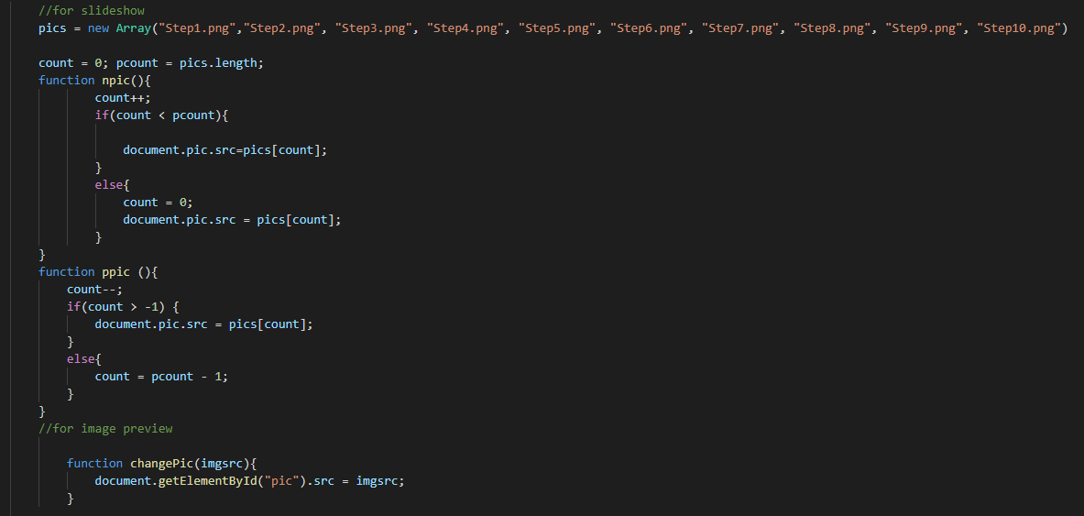

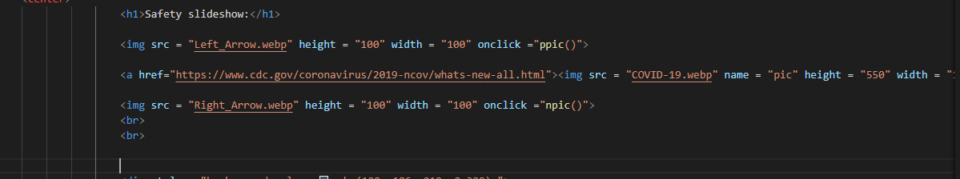
Safety slideshow
Coding
Output

Slide 6
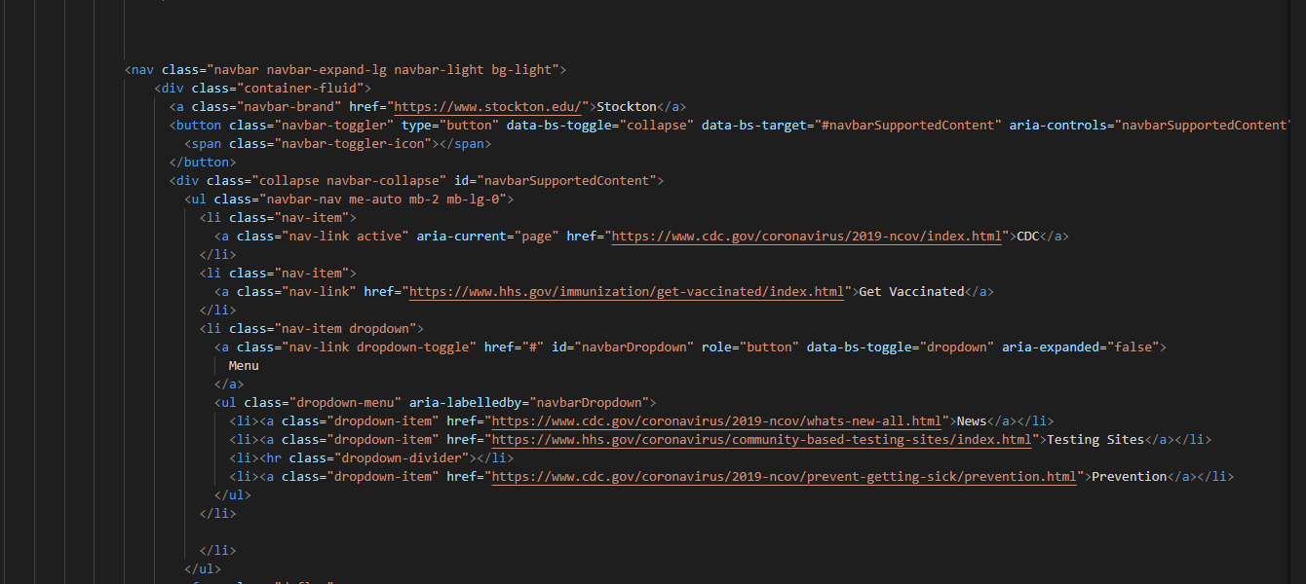
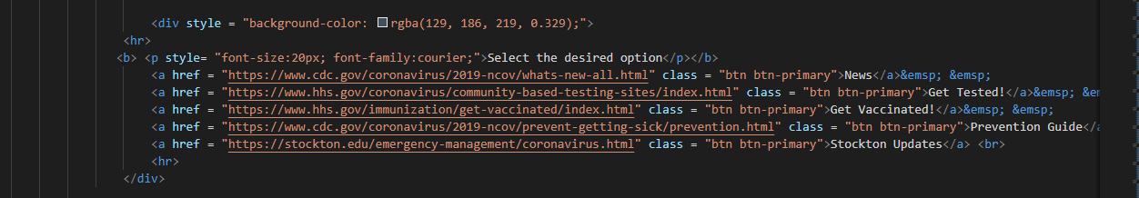


Selection Option
Coding
Output

Slide 7
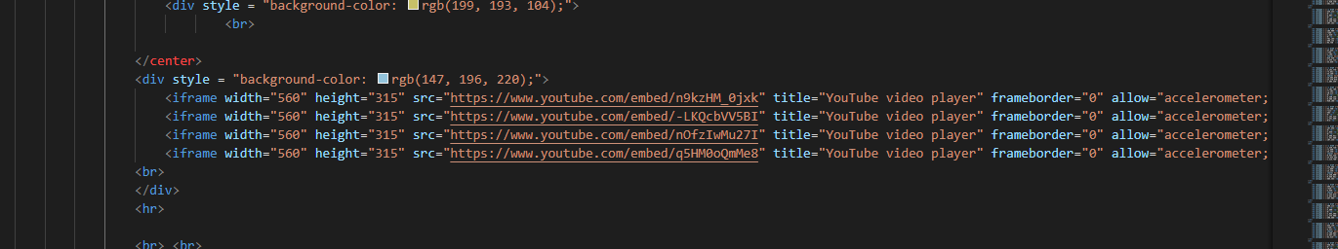

Youtube video
Coding
Output

Slide 8
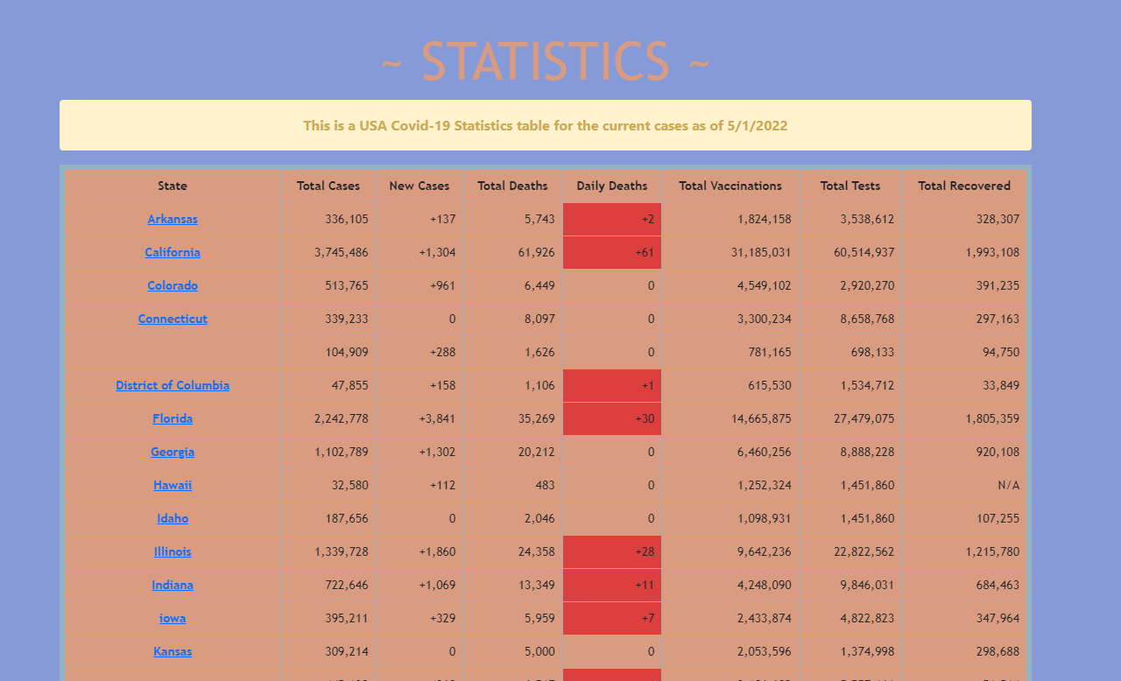
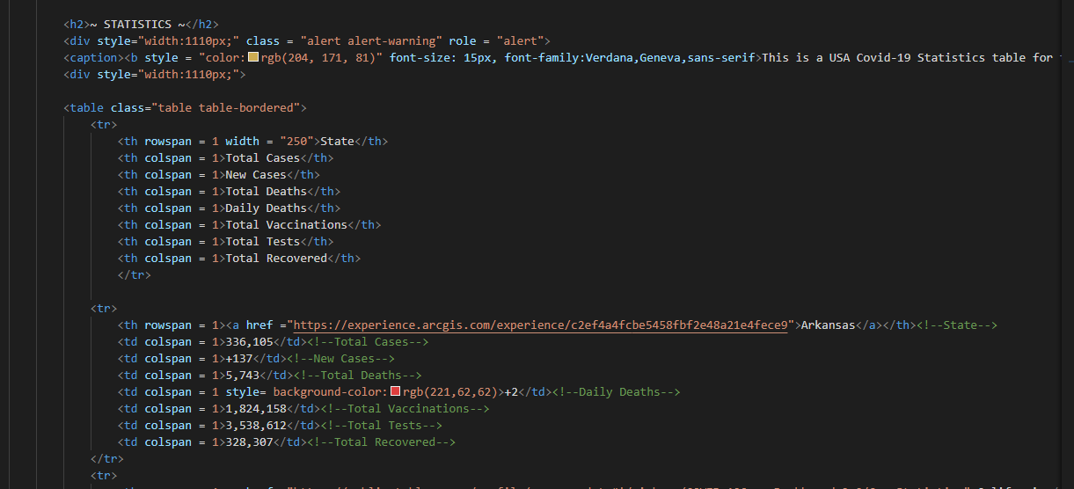
Table statistic:
Coding
Output

Slide 9

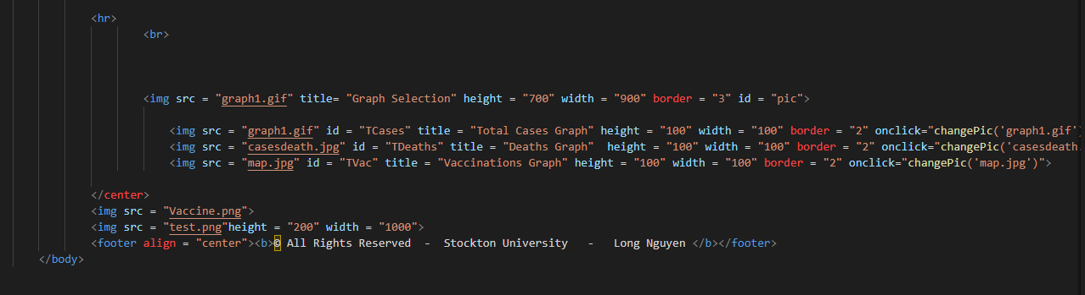
Photo click
Coding
Output

Slide 10
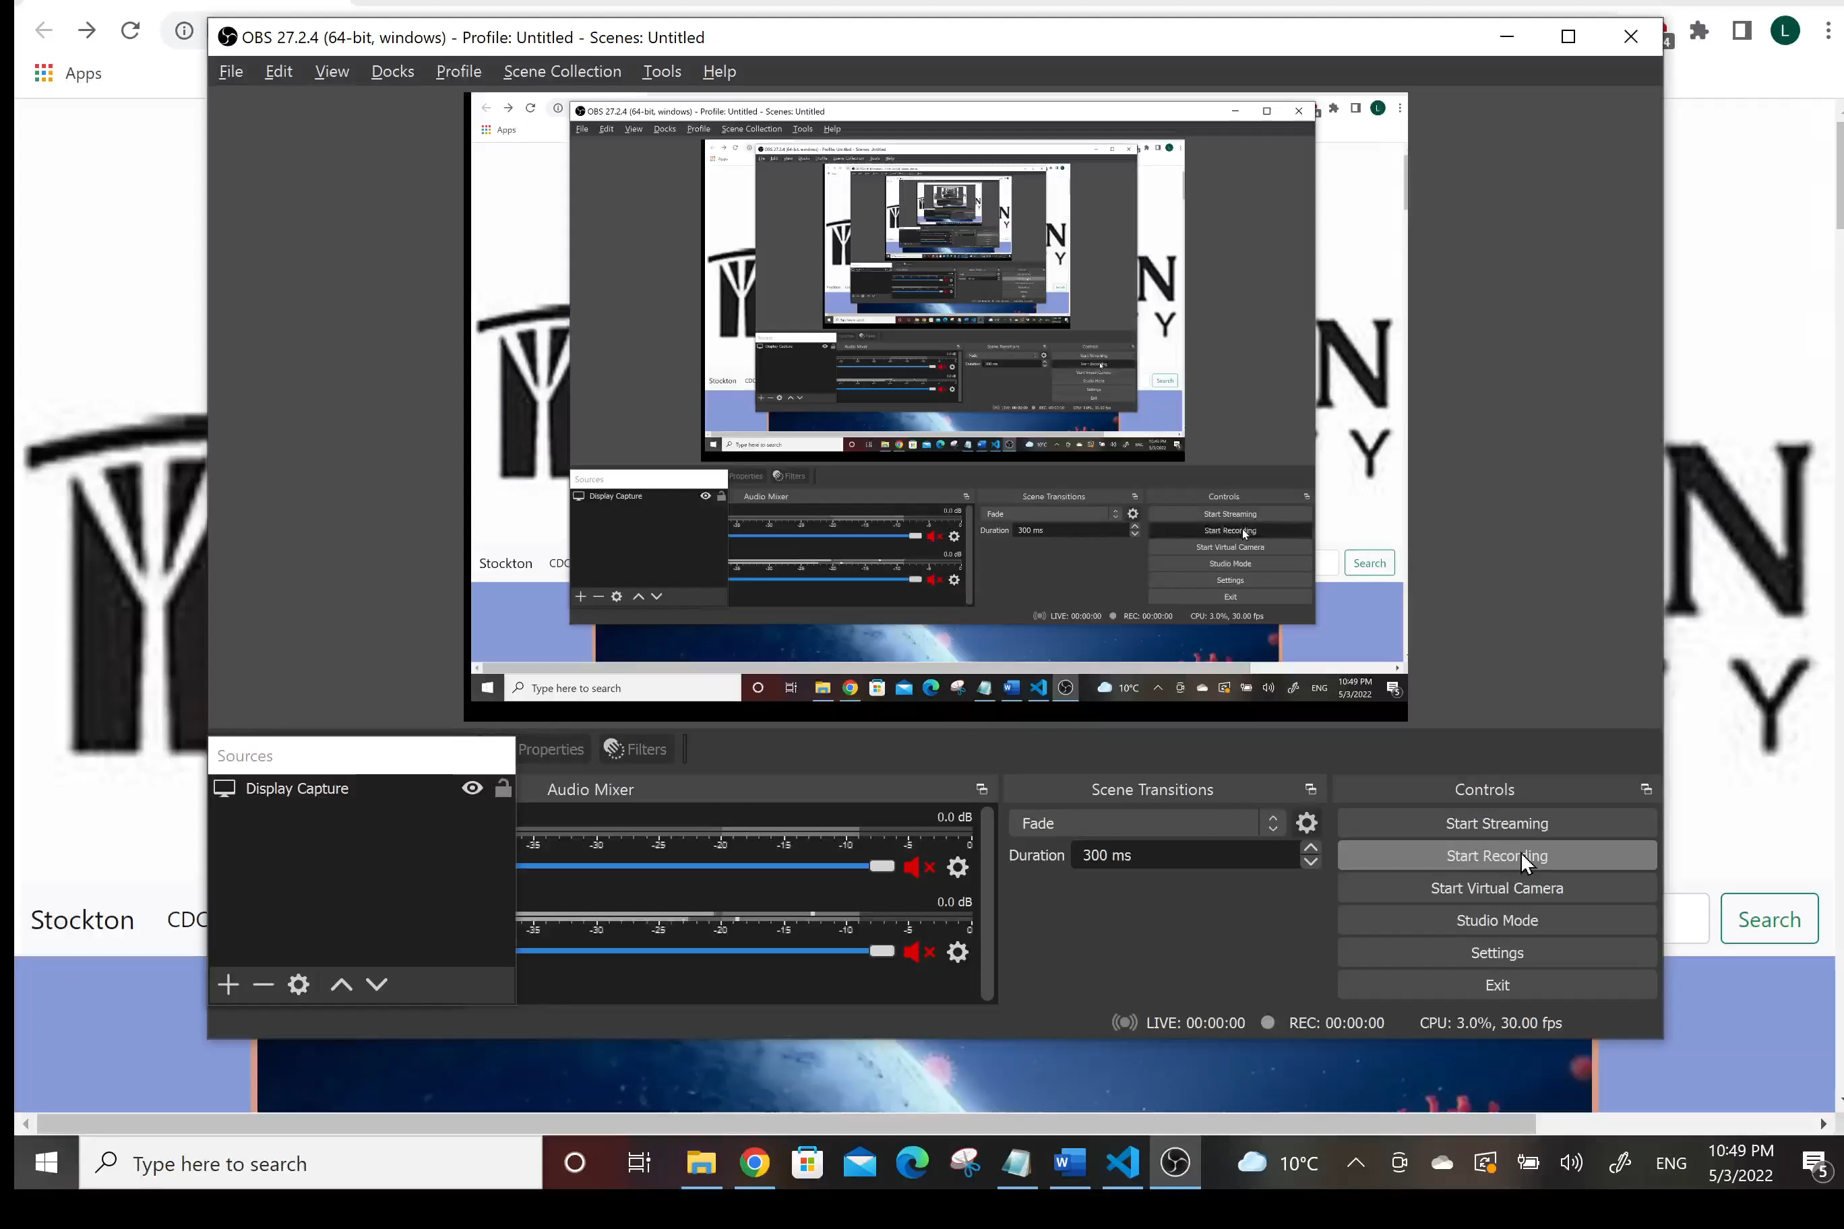
DeMo

Slide 11
Thank YOu
Do you have any question ?

